Slide 1


Slide 2
Chapter 10 Outline
Database Programming: Techniques and Issues
Embedded SQL, Dynamic SQL, and SQLJ
Database Programming with Function Calls: SQL/CLI and JDBC
Database Stored Procedures
and SQL/PSM
Comparing the Three Approaches
Slide 10- 2

Slide 3
Introduction to SQL
Programming Techniques
Database applications
  Host language
    Java, C/C++/C#, COBOL, or some other programming language
  Data sublanguage
    SQL
SQL standards
  Continually evolving
  Each DBMS vendor may have some variations from standard
Slide 10- 3

Slide 4
Database Programming: Techniques and Issues
Interactive interface
  SQL commands typed directly into a monitor
Execute file of commands
  @<filename>
  “source” in mysql
Application programs or database applications
  Used as canned transactions by the end users access a database
  May have Web interface
Slide 10- 4

Slide 5
Approaches to Database Programming
Embedding database commands in a general-purpose programming language
  Database statements identified by a special prefix
  Precompiler or preprocessor scans the source program code
    Identify database statements and extract them for processing by the DBMS
  Called embedded SQL
Slide 10- 5

Slide 6
Approaches to Database Programming (cont’d.)
Using a library of database functions
  Library of functions available to the host programming language
  Application programming interface (API)
Designing a brand-new language
  Database programming language designed from scratch
First two approaches are more common
Slide 10- 6

Slide 7
Impedance Mismatch
Differences between database model and programming language model
Binding for each host programming language
  Specifies for each attribute type the compatible programming language types
Slide 10- 7

Slide 8
Typical Sequence of Interaction in Database Programming
Open a connection to database server
Interact with database by submitting queries, updates, and other database commands
Terminate or close connection to database
Slide 10- 8

Slide 9
Embedded SQL, Dynamic SQL, and SQLJ
Embedded SQL
  C language
SQLJ
  Java language
Programming language called host language
Slide 10- 9

Slide 10
Retrieving Single Tuples with Embedded SQL
EXEC SQL
  Prefix
  Preprocessor separates embedded SQL statements from host language code
  Terminated by a matching END-EXEC
    Or by a semicolon (;)
Shared variables
  Used in both the C program and the embedded SQL statements
  Prefixed by a colon (:) in SQL statement
Slide 10- 10

Slide 11
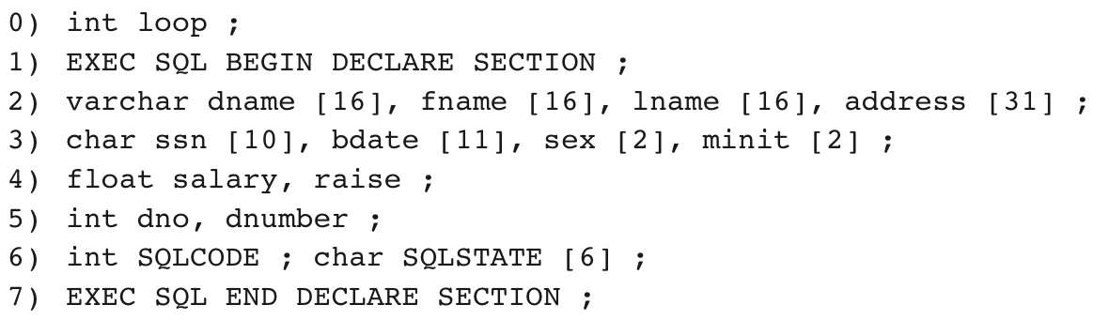
Figure 10.1 C program variables used in the embedded SQL examples E1 and E2.
Slide 10- 11

Slide 12
Retrieving Single Tuples with Embedded SQL (cont’d.)
Connecting to the database
  CONNECT TO <server name>AS <connection name>
  AUTHORIZATION <user account name and password> ;
Change connection
  SET CONNECTION <connection name> ;
Terminate connection
  DISCONNECT <connection name> ;
Slide 10- 12

Slide 13
Retrieving Single Tuples with Embedded SQL (cont’d.)
SQLCODE and SQLSTATE communication variables
  Used by DBMS to communicate exception or error conditions
SQLCODE variable
  0 = statement executed successfully
  100 = no more data available in query result
  < 0 = indicates some error has occurred
Slide 10- 13

Slide 14
Retrieving Single Tuples with Embedded SQL (cont’d.)
SQLSTATE
  String of five characters
  ‘00000’ = no error or exception
  Other values indicate various errors or exceptions
  For example, ‘02000’ indicates ‘no more data’ when using SQLSTATE
Slide 10- 14

Slide 15
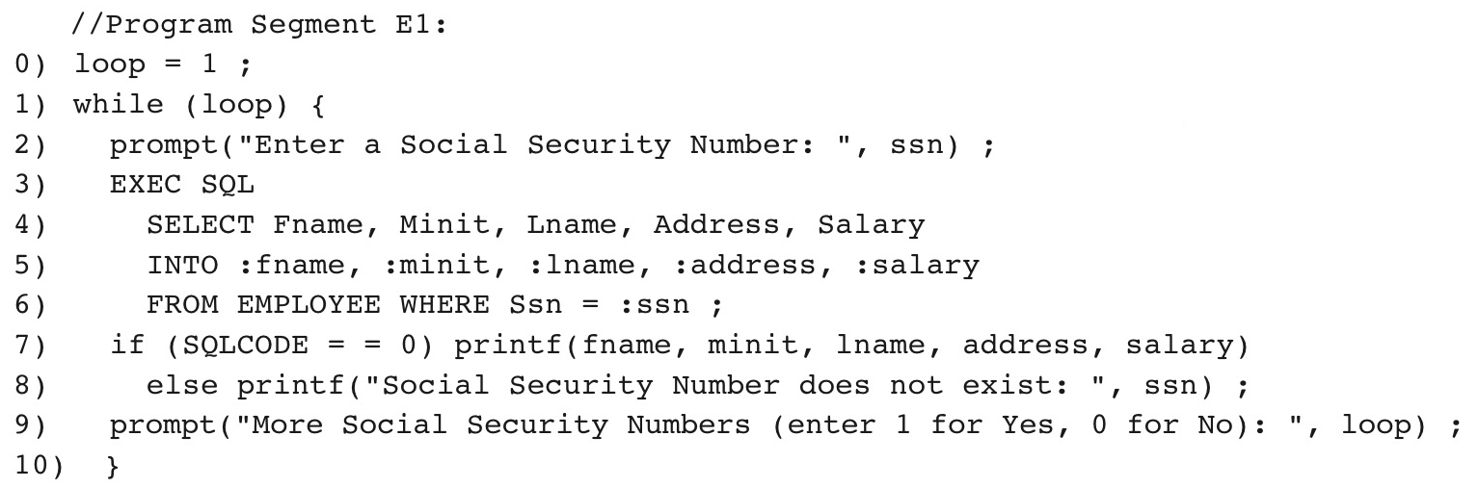
Figure 10.2 Program segment E1, a C program segment with embedded SQL.
Slide 10- 15

Slide 16
Retrieving Multiple Tuples with Embedded SQL Using Cursors
Cursor
  Points to a single tuple (row) from result of query
OPEN CURSOR command
  Fetches query result and sets cursor to a position before first row in result
  Becomes current row for cursor
FETCH commands
  Moves cursor to next row in result of query
Slide 10- 16

Slide 17
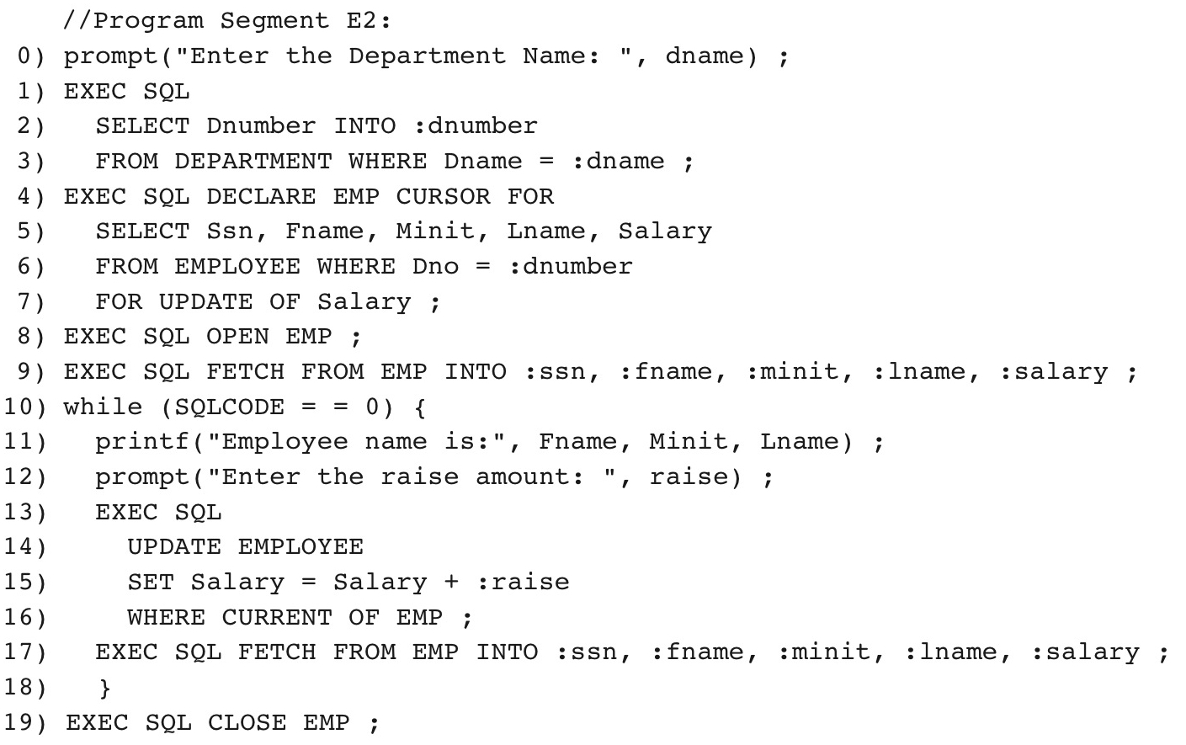
Figure 10.3 Program segment E2, a C program segment that uses cursors with embedded SQL for update purposes.
Slide 10- 17

Slide 18
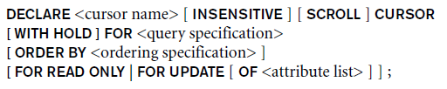
Retrieving Multiple Tuples with Embedded SQL Using Cursors (cont’d.)
FOR UPDATE OF
  List the names of any attributes that will be updated by the program
Fetch orientation
  Added using value: NEXT, PRIOR, FIRST, LAST, ABSOLUTE i, and RELATIVE i
Slide 10- 18

Slide 19
Specifying Queries at Runtime Using Dynamic SQL
Dynamic SQL
  Execute different SQL queries or updates dynamically at runtime
Dynamic update
Dynamic query
Slide 10- 19

Slide 20
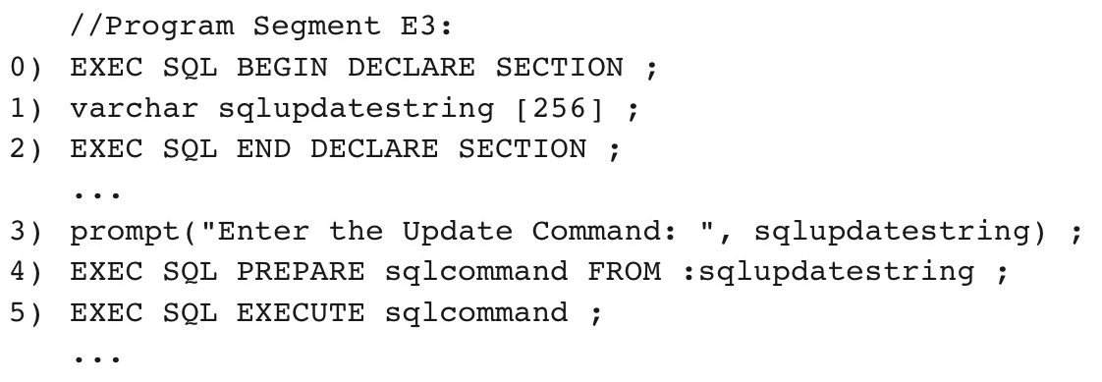
Figure 10.4 Program segment E3, a C program segment that uses dynamic SQL for updating a table.
Slide 10- 20

Slide 21

Figure 10.4 Program segment E3, a C program segment that uses dynamic SQL for updating a table.
Note: This is a terrible idea, but it illustrates how to create dynamic statements
Slide 10- 20

Slide 22
SQLJ: Embedding SQL Commands in Java
Standard adopted by several vendors for embedding SQL in Java
Import several class libraries
Default context
Uses exceptions for error handling
  SQLException is used to return errors or exception conditions
Slide 10- 21

Slide 23
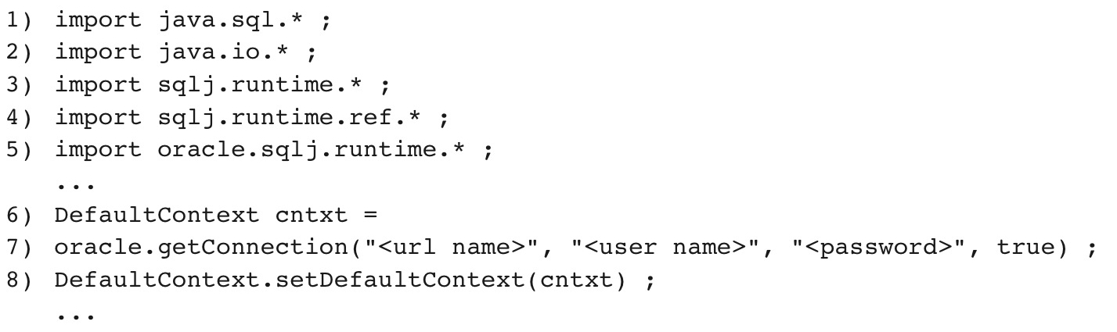
Figure 10.5 Importing classes needed for including SQLJ in Java programs in Oracle, and establishing a connection and default context.
Slide 10- 22

Slide 24
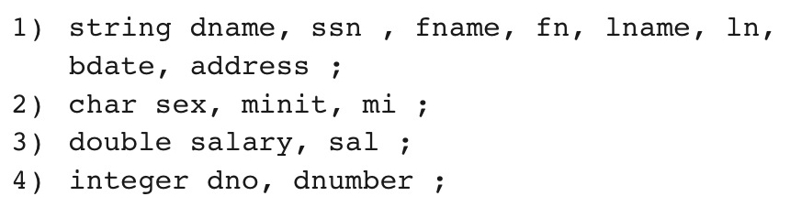
Figure 10.6 Java program variables used in SQLJ examples J1 and J2.
Slide 10- 23

Slide 25
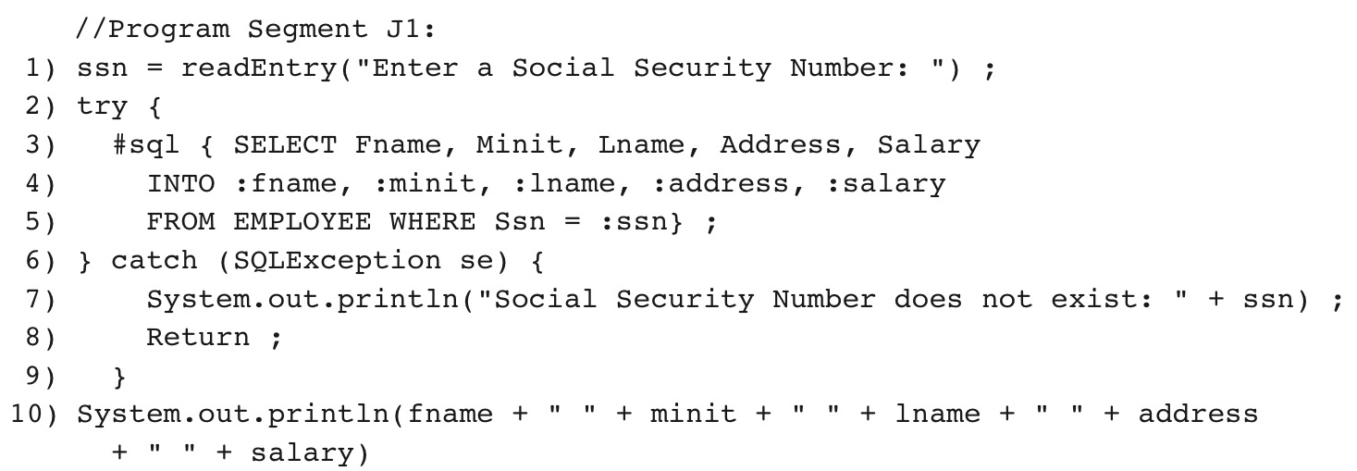
Figure 10.7 Program segment J1, a Java program segment with SQLJ.
Slide 10- 24

Slide 26
Retrieving Multiple Tuples in SQLJ Using Iterators
Iterator
  Object associated with a collection (set or multiset) of records in a query result
Named iterator
  Associated with a query result by listing attribute names and types in query result
Positional iterator
  Lists only attribute types in query result
Slide 10- 25

Slide 27
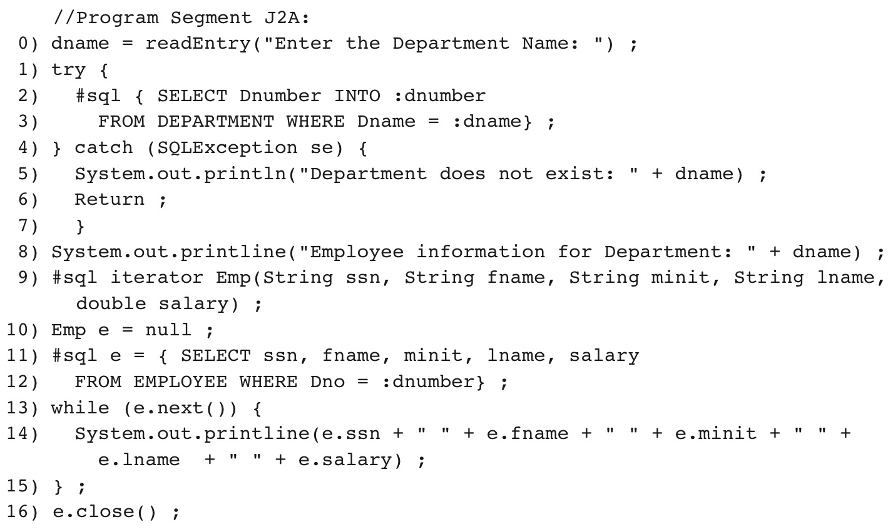
Figure 10.8 Program segment J2A, a Java program segment that uses a named iterator to print employee information in a particular department.
Slide 10- 26

Slide 28
Embedded SQL
We need Embedded SQL in C
  C is not object oriented, so we can’t make a class to work with the database
Java is object oriented though
So we can use the object oriented paradigms to create a library specifically for accessing databases
  Already done for us, called JDBC
  Available for other languages as ODBC
Slide 8<number>

Slide 29
JDBC: SQL Function Calls for Java Programming
JDBC
  Java function libraries
Single Java program can connect to several different databases
  Called data sources accessed by the Java program
Slide 10- 33

Slide 30
JDBC: SQL Function Calls for Java Programming
Connection object
Statement object has two subclasses:
  PreparedStatement and CallableStatement
Question mark (?) symbol
  Represents a statement parameter
  Determined at runtime
ResultSet object
  Holds results of query
Slide 10- 34

Slide 31
Using JDBC
1. Import java.sql.*
2. Load your driver
3. Create your connection
4. Run your Queries
  A. Prepare your statement
  B. Bind your variables
  C. Execute Query
  D. Parse ResultSet
    Load into objects
    Handle NULLS
5. Close your connection
Slide 8- <number>

Slide 32
Loading your driver
JDBC can work with any SQL DBMS implementation
  But it needs to know what implementation to use
  You need to tell it what driver to load, depending on what DBMS you are using
  Each DBMS provides its own JDBC driver
Oracle
  Class.forName("oracle.jdbc.driver.OracleDriver")
MySQL
  Class.forName(“com.mysql.jdbc.Driver")
Done in a try catch incase the driver can’t be found
After this, it does not matter which DBMS you are using, they all work with the same interface
Slide 8- <number>

Slide 33
Create your Connection
JDBC libraries provides a Connection class that handles your connection to your database
  Declare an object of type Connection
    Connection conn;
    Common to make it private and static for security.
We don’t call a Connection constructor
  It’s dependent on the DBMS being used
  We call DriverManager.getConnection(String db, String user, String pw)
Slide 8- <number>

Slide 34
Create your Connection
Conn = DriverManager.getConnection(db, user, pw);
  Db – Database address
    jdbc:mysql://<machine>:<port>/<database_name
    <machine> - mysql1.cs.clemson.edu
    <port> - 3306
      Default mysql port
    <database_name> - you named it when you created it.
  User – your user name
  Pw – password you set for the database, not for mysql in general
Slide 8- <number>

Slide 35
Run Query - Statements
Statement interface provided in the JDBC library
  Statements are the queries we want to run
  We create a string with our SQL Query and wrap it in our Statement object
Two extensions PreparedStatement and CallableStatement
  PreparedStatements use parameter binding, which is more secure that creating a query string ourselves
    Creates a separation between the query, and the data
  CallableStatements are for running Stored Procedures, not queries
Statements not instantiated through a constructor
  Must be created through the Connection object
Slide 8- <number>

Slide 36
Run Queries - Statements
Statements
//Statement is empty
Statement stmt = conn.createStatement();
int deptNum = 5;
String query = “Select fname, lname, salary from Employee where Dno = “ + deptNum + “;”;
//Query is passed into statement when it’s time to execute
ResultSet rset = stmt.executeQuery(query);
Slide 8- <number>

Slide 37
PreparedStatements
PreparedStatements create the Statement with the query and without the data, then bind the data to the query
Use “?” to show places in the Query where data will be placed
Use clearParameters() to remove any data from the PreparedStatement
  Done for safety and sanity
Use setString(int pos, String data) to replace your ? With data
  Pos says which ? To replace with the data
  Indexing starts at 1
Slide 8- <number>

Slide 38
PreparedStatements
String query = “Select fname, lname, salary from Employee where Dno = ?;“;
//Statement is created with a data less query
PreparedStatement stmt = conn.prepareStatement(query);
int deptNum = 5;
//clear any parameters as a sanity check
stmt.clearParameters();
//Data now bound to the query
Stmt.setString(1, deptNum);
//run the query
ResultSet rSet = stmt.executeQuery();
Slide 8- <number>

Slide 39
Run your Query
Once your Statements are ready, you can run your Query using executeQuery()
  Returns the results in a ResultSet object
If using Statement
  Need to pass in the string with the query as a parameter
  ResultSet rset = stmt.executeQuery(query);
If using PreparedStatement
  PreparedStatement already has the query and data, no parameter necessary
  ResultSet rSet = stmt.executeQuery();
Slide 8- <number>

Slide 40
ResultSet
ResultSet is another class provided by our JDBC library to help us handle the impedance mismatch
  Java representation of a table that a SQL statement returns
  Each row is a tuple
  Each column is an attribute
Slide 8- <number>

Slide 41
Iterating through your ResultSet
boolean ResultSet.next() gets the next tuple
  Even if there is only one result in the ResultSet, you need to call it to get to the first result
  Returns false when there are no more tuples in the result
    Can use in a while statement to loop through the whole ResultSet
Slide 8- <number>

Slide 42
Get values from ResultSet
Now that you are looking at one particular tuple, how can you get the individual attribute values?
String ResultSet.getString(int columnIdx)
  Gets the value in column columnIdx
    Indexing starts at 1
String ResultSet.getString(String fieldname)
  Gets the value in column with the attribute name fieldname
Slide 8- <number>

Slide 43
Get values from ResultSet
We also have get methods for other datatypes than String that work the same way
  getInt(), getDouble(), etc.
Why not just Integer.parseInt(rset.getString(1));?
  Integer.parseInt can’t handle a NULL value
  rset.getInt(1) can
Slide 8- <number>

Slide 44
Handling null values
We need to handle Null values in a way that is meaningful to our program
boolean ResultSet.wasNull()
  Returns true if the last value returned in a get call was a NULL value
Slide 8- <number>

Slide 45
Close your connection
Closing your connection is easy
  conn.close();
Why not just leave the connection open for other queries?
  Security concern – someone could hijack the connection
  You don’t want to assume the connection is already open
    If it’s not, you’ll get an exception
    Save that for network connection errors
Best Practice: For each specific task in the DB open the connection at the beginning, then close as soon as you are done with the database
Close in Catch blocks as well
Slide 8- <number>

Slide 46
What about non-Queries?
Inserts? Updates?
Your Query string just needs to be an insert or an update command
Everything else works the same
  It just returns an empty ResultSet
Slide 8- <number>

Slide 47
Programming with JDBC best practices
Remember separation of concerns
  Have ONE utility class that actually interacts with the database
    Easier to adapt to change
      DB design changes? Need to change query strings?
      Change to a new DBMS?
    Easier to enforce security protocols
  Make it’s methods static
    Methods return data in the objects your program uses
  Other classes call the utility class methods
    Method signatures won’t change
Slide 8- <number>

Slide 48
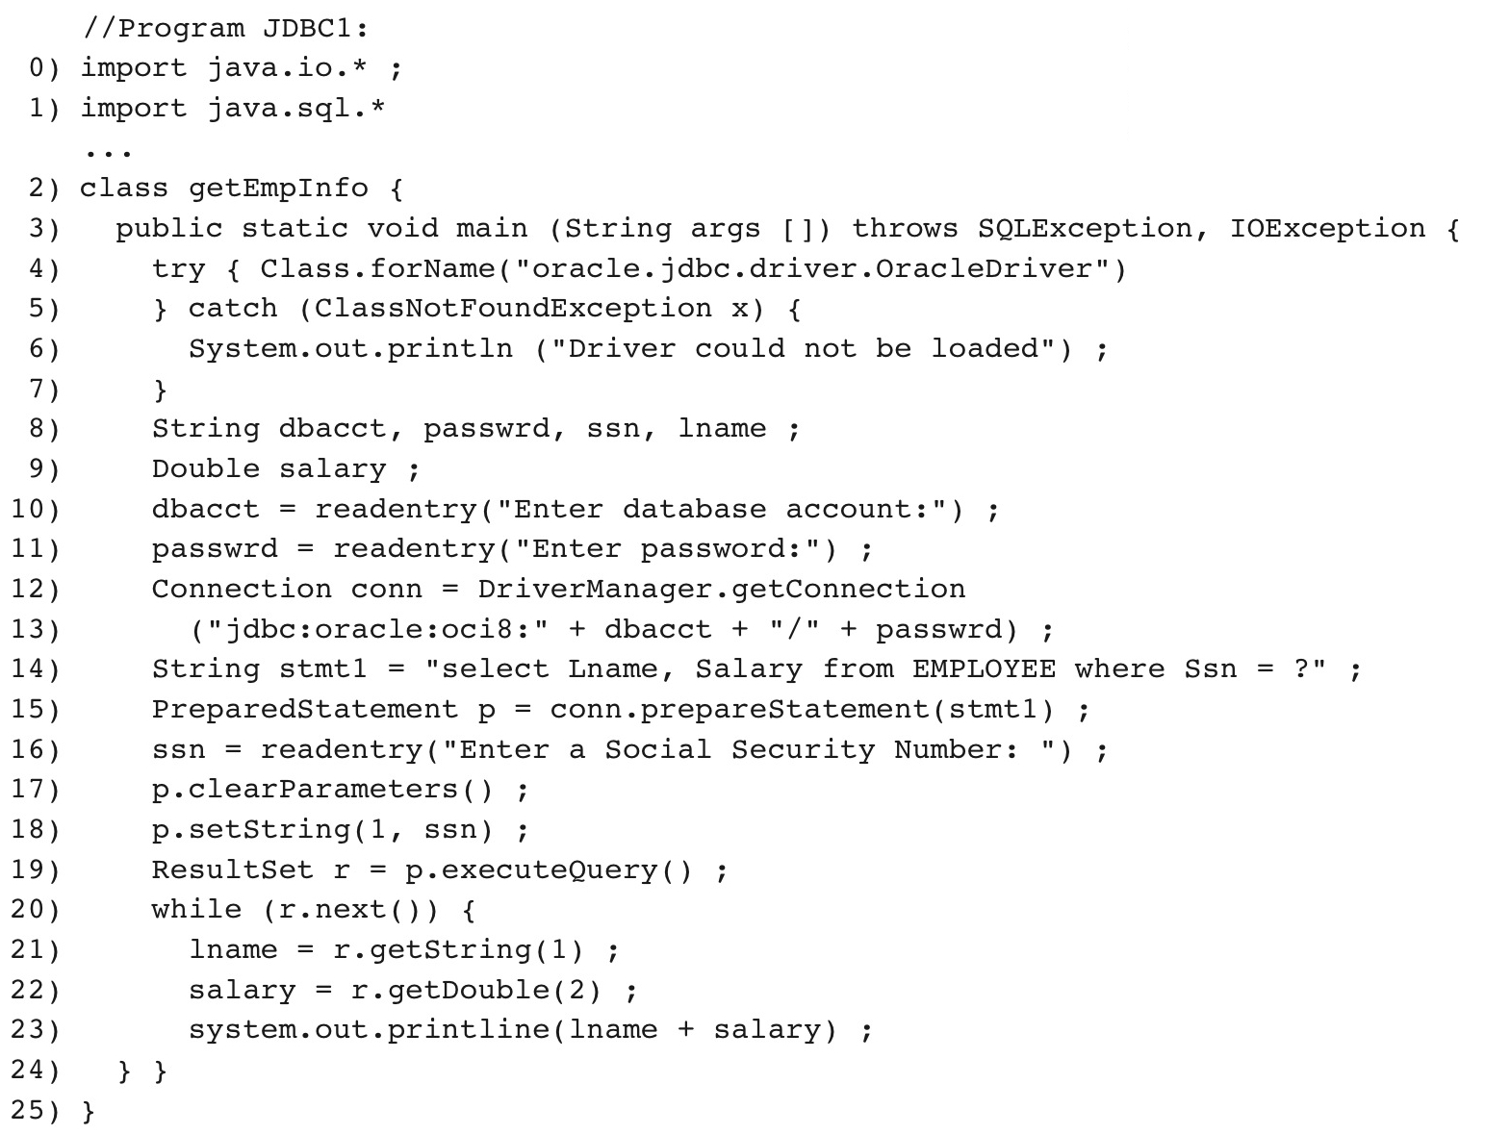
Figure 10.12 Program segment JDBC1, a Java program segment with JDBC.
Slide 10- 35

Slide 49
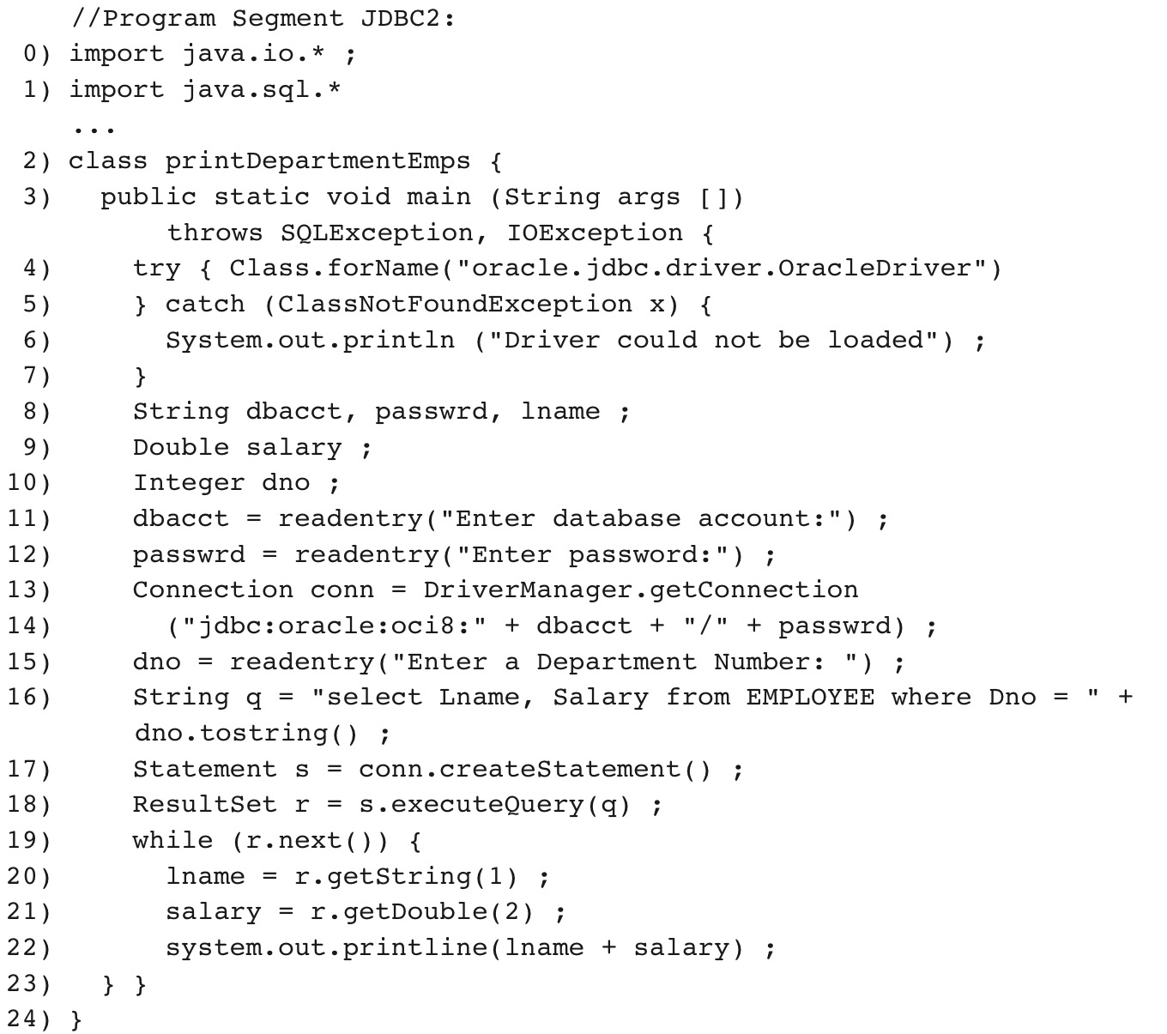
Figure 10.13 Program segment JDBC2, a Java program segment that uses JDBC for a query with a collection of tuples in its result.
Slide 10- 36

Slide 50
JDBC vs ODBC
The syntax is not exactly the same
However, it is very similar
  Going from one to another is not difficult
Slide 8<number>

Slide 51
Database Stored Procedures and SQL/PSM
Stored procedures
  Program modules stored by the DBMS at the database server
  Can be functions or procedures
SQL/PSM (SQL/Persistent Stored Modules)
  Extensions to SQL
  Include general-purpose programming constructs in SQL
Slide 10- 37

Slide 52
Database Stored Procedures and Functions
Persistent stored modules
  Stored persistently by the DBMS
Useful:
  When database program is needed by several applications
  To reduce data transfer and communication cost between client and server in certain situations
  To enhance modeling power provided by views
Slide 10- 38

Slide 53
Database Stored Procedures and Functions (cont’d.)
Declaring stored procedures:
  CREATE PROCEDURE <procedure name> (<parameters>)
  <local declarations>
  <procedure body> ;
  declaring a function, a return type is necessary, so the declaration form is
  CREATE FUNCTION <function name> (<parameters>)
  RETURNS <return type>
  <local declarations>
  <function body> ;
Slide 10- 39

Slide 54
Database Stored Procedures and Functions (cont’d.)
Each parameter has parameter type
  Parameter type: one of the SQL data types
  Parameter mode: IN, OUT, or INOUT
Calling a stored procedure:
  CALL <procedure or function name> (<argument list>) ;
Slide 10- 40

Slide 55
SQL/PSM: Extending SQL for Specifying Persistent
Stored Modules
Conditional branching statement:
  IF <condition> THEN <statement list>
  ELSEIF <condition> THEN <statement list>
  ...
  ELSEIF <condition> THEN <statement list>
  ELSE <statement list>
  END IF ;
Slide 10- 41

Slide 56
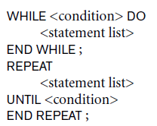

SQL/PSM (cont’d.)
Constructs for looping
Slide 10- 42

Slide 57
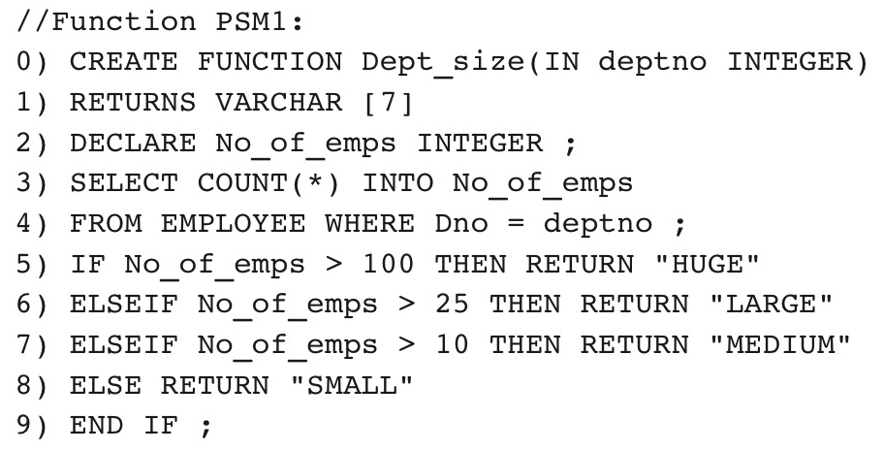
Figure 10.14 Declaring a function in SQL/PSM.
Slide 10- 43

Slide 58
CallableStatements
The CallableStatements Interface extends the PreparedStatements Interface
  Made specifically to call stored procedures directly
  Uses parameter binding
Instantiated with Connection.prepareCall(String call)
  Call format “{call <procedureName>(?,? ...?)}”
Uses setString(int pos, String data) for parameter binding.
Run with CallableStatement.execute();
Slide 8<number>

Slide 59
CallableStatements with output
What if our stored procedure has out Parameters?
Just like how we used setString to bind our input, we use registerOutParameter(int pos, <datatype>) to bind our output
  Datatypes exist in java.sql.types
Then we have our getString(int pos) methods to get the output value
Slide 8- <number>

Slide 60
CallableStatements with output
//getDBUSERByUserId is a stored procedure
String getDBUSERByUserIdSql = "{call getDBUSERByUserId(?,?,?,?)}";
callableStatement = dbConnection.prepareCall(getDBUSERByUserIdSql);
callableStatement.setInt(1, 10);
callableStatement.registerOutParameter(2, java.sql.Types.VARCHAR);
callableStatement.registerOutParameter(3, java.sql.Types.VARCHAR);
callableStatement.registerOutParameter(4, java.sql.Types.DATE);
// execute getDBUSERByUserId store procedure
callableStatement.executeUpdate();
String userName = callableStatement.getString(2);
String createdBy = callableStatement.getString(3);
Date createdDate = callableStatement.getDate(4);
Slide 8- <number>

Slide 61
Why use stored procedures
Couldn’t we do everything in a stored procedure in our database utility class
  Yes, and with more control
More transactions between program and database
  Larger load on the network
Changes to the DB can be localized to the DB server
  If the tables change, change the stored procedure, not the Java code
Hides database structure details
Slide 8- <number>

Slide 62
Web Programming and Databases
What about connecting to our database via a web interface
  So many Web technologies
  Changes frequently
However, most either have embedded SQL or a library to use to make database calls
Slide 8<number>

Slide 63
Web Programming concerns
Where is the code running
  Running on client machine (javascript)
    The client can see your SQL statements!
  Running on server?
    It can be a regular OOP language that is called by the website
      Use JDBC or ODBC
Slide 8- <number>

Slide 64

Three-tier client-server architecture
Slide 2- <number>

Slide 65
Comparing the Three Approaches
Embedded SQL Approach
  Query text checked for syntax errors and validated against database schema at compile time
  For complex applications where queries have to be generated at runtime
    Function call approach more suitable
Slide 10- 44

Slide 66
Comparing the Three Approaches (cont’d.)
Library of Function Calls Approach
  More flexibility
  More complex programming
  No checking of syntax done at compile time
Database Programming Language Approach
  Does not suffer from the impedance mismatch problem
  Programmers must learn a new language
Slide 10- 45

Slide 67
Summary
Techniques for database programming
  Embedded SQL
  SQLJ
  Function call libraries
  SQL/CLI standard
  JDBC class library
  Stored procedures
  SQL/PSM
Slide 10- 46

